Slide 1

ESG
Data Project

Slide 2
Key Takeaways
“A sustainable business is resource efficient, respects the environment, and is a good neighbour” - Phil Harding
Most Important Credit Features | Order of Importance for ESG | Moving Forward
Quick ratio, profit growth, and loan size | Each sector has a different order and focus area | Utilize Machine Learning (ML) to assess future loans
 | In general: Governance Environment Social | Use metrics to implement flexible incentive programs and improve ML model

Slide 3

01
Loan Factors
02
Default Rates Analysis
03
Recommendations
04
Sustainability-Linked Loan
features
credit risk component
policies
actionable insights

Slide 4

01
Loan Factors
A Machine Learning Approach

Slide 5

Decision Tree Models
Performance
74.67%
73.33%
50.50%
Loan Factors | Default Rates | Recommendations | Sustainability-Linked Loans
*Credit Data Only
Credit & ESG Data
**ESG Data Only
*model selected to determine the credit features
**model selected to determine the ESG features

Slide 6
Credit Features
quick ratio, profit growth, and loan size determines default rate
Loan Factors | Default Rates | Recommendations | Sustainability-Linked Loans
Quick Ratio | Profit Growth | Loan Size
liquidity of company | profitability of company | amount borrowed
those with higher quick ratio has a propensity to not default | those with higher profit growth has a propensity to not default | those with higher loan size has a propensity to not default

Slide 7
ESG Features
overall order of focus should be on governance, then environment, then social features
Loan Factors | Default Rates | Recommendations | Sustainability-Linked Loans
Governance | Environment | Social
how a corporation polices itself | how a corporation acts as steward of our natural environment | how a corporation treats people

Slide 8

02
Default Rate Analysis

Slide 9

Credit Risk Component
Expected Loss
Trends
Sustainability
Loan Factors | Default Rates | Recommendations | Sustainability-Linked Loans
each sector estimated normalized default loss
trend of default rate of each sector
sector’s relationship to ESG features

Slide 10
Expected Loss
$ in million USD
Default Probability and Expected Loss is the Highest for Sector 10 and Lowest for Sector 5.
In general, higher default rates lead to higher expected loss.
Loan Factors | Default Rates | Recommendations | Sustainability-Linked Loans
Sectors
Default Rate
Expected Loss
1
2
3
4
5
6
7
8
9
10
52%
47%
49%
52%
46%
50%
49%
58%
45%
65%
$43
$33
$44
$46
$36
$39
$44
$60
$39
$86
*full calculation located in Appendix: Default Loss Calculation

Slide 11
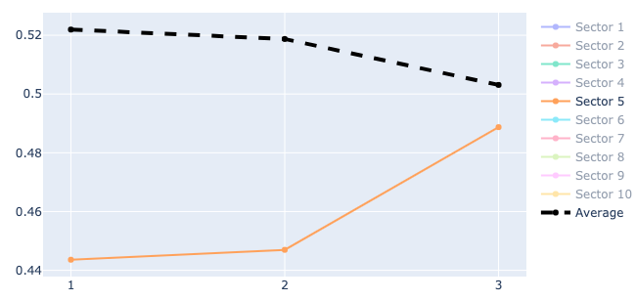
Sector Default Rate Trend
Loan Factors | Default Rates | Recommendations | Sustainability-Linked Loans
Overenthusiastic
Clear Upward Trend:
Sector 5

Slide 12
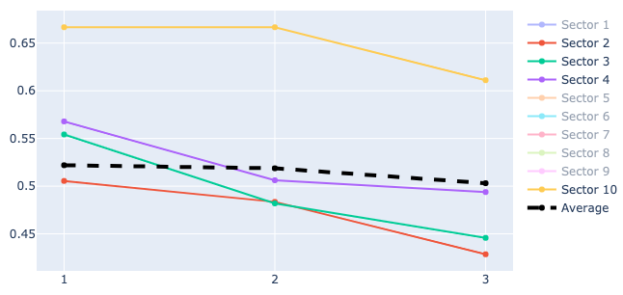
Sector Default Rate Trend
Loan Factors | Default Rates | Recommendations | Sustainability-Linked Loans
Cautious
Clear Downward Trend:
Sectors 2, 3, 4, and 10

Slide 13
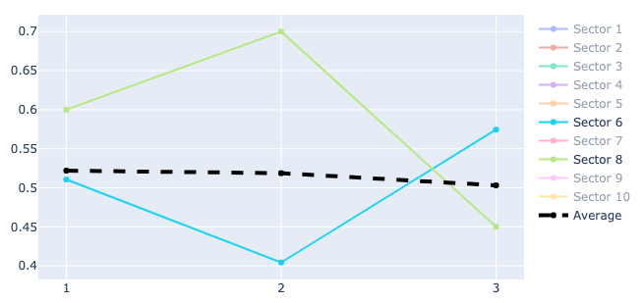
Sector Default Rate Trend
Loan Factors | Default Rates | Recommendations | Sustainability-Linked Loans
Indecisive
Volatile and Reversing Trend:
Sectors 6 and 8

Slide 14
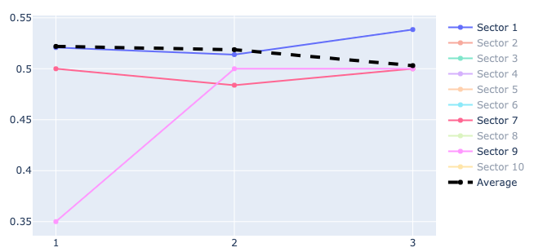
Sector Default Rate Trend
Loan Factors | Default Rates | Recommendations | Sustainability-Linked Loans
Misfits
Inconclusive:
Sectors 1, 7, and 9

Slide 15
Average ESG-Default Rate Relation
Default occurrences in each sector are affected by ESG scores differently
Depending on the sector’s business line, different subsets of the metrics can be focused on to devise sustainability performance targets
Loan Factors | Default Rates | Recommendations | Sustainability-Linked Loans
Sectors | Environment | Social | Governance
1 / 3 | negative score leads to lower default rates
2 |  |  | positive score leads to lower default rates
4 |  |  | negative score leads to lower default rates
5 / 6 |  | score <= -0.05 leads to lower default rates
7 |  | score >= 0.15 leads to lower default rates
8 / 9 / 10 | positive score leads to lower default rates
*graphical representation located in the Appendix: ESG Sector Graphical Breakdown

Slide 16

03
Recommendations

Slide 17
Trend Personalities
Loan Factors | Default Rates | Recommendations | Sustainability-Linked Loans
Overenthusiastic
Only offer short-term loans
Clear Upward Trend: Sector 5
Cautious
Charge lower interest rates
Clear Downward Trend: Sectors 2, 3, 4, 10
Indecisive
Charge higher interest rates
Unpredictable: Sectors 6, 8
Misfits
Charge baseline interest rates
Inconclusive: Sectors 1, 7, 9

Slide 18
Policies
Default Rate (Segment) Approach
ESG (Sector) Approach
Credit Approach
Loan Factors | Default Rates | Recommendations | Sustainability-Linked Loans
Apply policies based on the personality of the sector
Include ESG considerations in loan policies by sector
Focus: subset of ESG metrics that align with the company’s business activity
Benefits or penalties could be imposed depending on the company’s standing relative to the sector’s ESG targets
*High Quick Ratio, Profit Growth, and Loan Amount
Require high quick ratio overall
Require high profit growth if low quick ratio
Require high loan amount if low quick ratio and profit growth
*decision tree visual breakdown located in Appendix: Decision Tree

Slide 19

04
Sustainability
-Linked Loan

Slide 20

Actionable Insights
Steps
Metrics
Goal: reduce default rates while promoting sustainability through ESG
Loan Factors | Default Rates | Recommendations | Sustainability-Linked Loans
ML prediction should improve.
Accuracy, Precision-Recall, AUC, ROC
Specific ESG scores over time should improve, which depends on sector
Normalized ESG scores
Using ML, identify loans that have a low propensity to default based on credit data
Based on the sector of the company, rollout flexible strategies and incentives to promote ESG
Repayment period, Loan period, Settlement period, Interest rate
Notes:
Example: Sector 8 / 9 / 10 would get more favorable interest rate if their Environment scores improve
repayment period, loan period, settlement period, interest rate

Slide 21
Recap
“A sustainable business is resource efficient, respects the environment, and is a good neighbour” - Phil Harding
Most Important Credit Features | Order of Importance for ESG | Moving Forward
Quick ratio, profit growth, and loan size | Each sector has a different order and focus area | Utilize Machine Learning (ML) to assess future loans
 | In general: Governance Environment Social | Use metrics to implement flexible incentive programs and improve ML model

Slide 22

Q/A

Slide 23
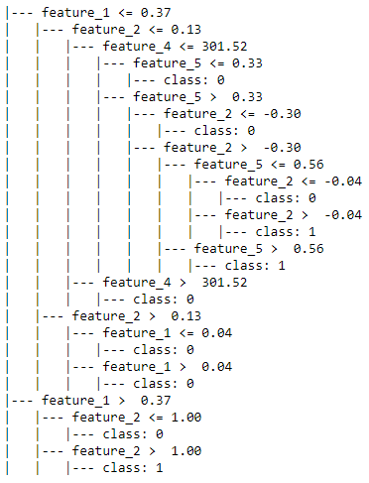
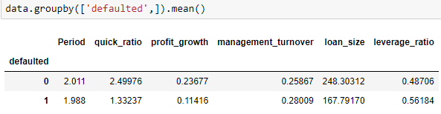
Appendix
Decision Tree
Feature 1 (Quick Ratio) / Feature 2 (Profit Growth) / Feature 4 (Loan Size) / Feature 5 (Leverage Ratio)
If Quick Ratio > 0.37 and Profit Growth <= 1.00 [NOT DEFAULT]
If Quick Ratio <= 0.37 and Profit Growth > 0.13 [NOT DEFAULT]
If Quick Ratio <= 0.37 and Profit Growth <= 0.13 and Loan Size > 301.52 [NOT DEFAULT]
If Quick Ratio <= 0.37 and Profit Growth <= 0.13 and Loan Size <= 301.52 [HIGHER DEFAULT PROBABILITY]

Slide 24
Appendix
Decision Tree (cont.)
Quick Ratio
High
Low
Class =
Not Default
Profit Growth
High
Low
Class =
Not Default
Loan Size
High
Low
Class =
Not Default
Class =
Default

Slide 25
Appendix
Default Loss Calculation
Sectors
Default Probability
Loss Given Default
Expected Loss
1
2
3
4
5
6
7
8
9
10
52%
47%
49%
52%
46%
50%
49%
58%
45%
65%
$35,649
$19,229
$22,108
$21,621
$31,341
$11,109
$8,139
$6,255
$5,239
$7,103
= 52% x 35,649 / 431 = $43
= 47% x $19,229 / 273 = $33
= 49% x $22,108 / 249 = $44
= 52% x $21,621 / 243 = $46
= 46% x $31,341 / 398 = $36
= 50% x $11,109 / 141 = $39
= 49% x $8,139 / 91 = $44
= 58% x $6,255 / 60 = $60
= 45% x $5,239 / 60 = $39
= 65% x $7,103 / 54 = $86

Slide 26
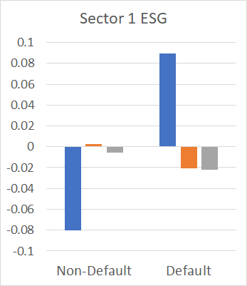
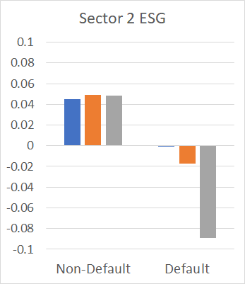
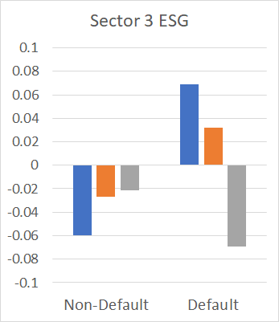
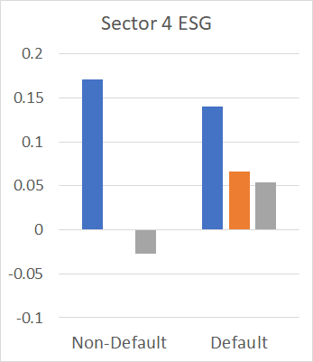
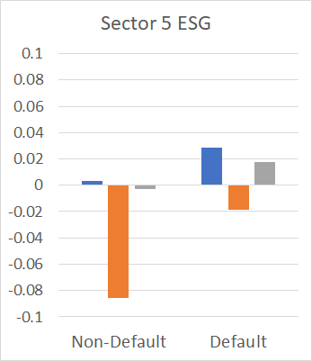
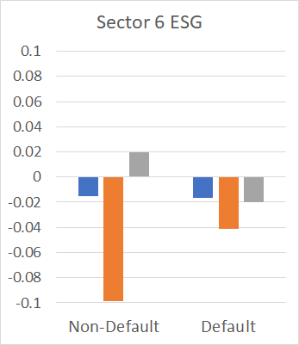
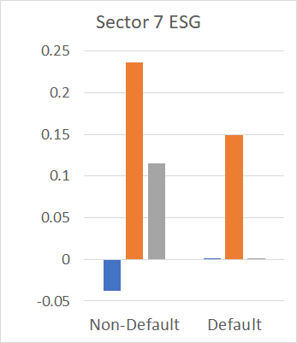
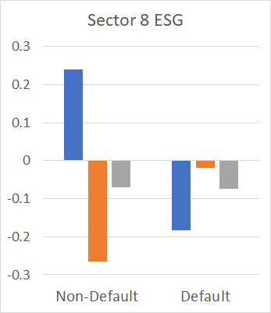
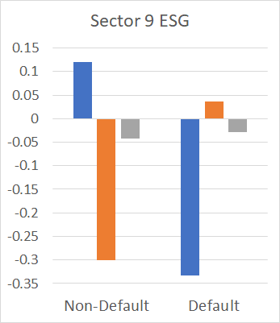
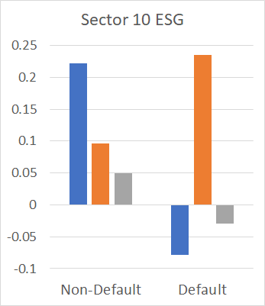
Appendix
ESG Sector Graphical Breakdown

Slide 27
Appendix
ESG Prediction Formula By Sector
Sector | Formula | Accuracy
1 | 0.22 + 0.1025 x Environment + 0.0105 x Social + -0.0396 x Governance | 42.53%
2 | -0.18 + -0.1617 x Environment + 0.0435 x Social + -0.625 x Governance | 54.55%
3 | -0.14 + 0.1737 x Environment + 0.116 x Social + -0.2034 x Governance | 40%
4 | 0.11 + 0.014 x Environment + 0.0695 x Social + 0.591 x Governance | 38.78%
5 | -0.19 + -0.0315 x Environment + 0.1603 x Social + -0.0577 x Governance | 48.75%
6 | 0.11 + 0.0775 x Environment + 0.0525 x Social + -0.177 x Governance | 37.93%
7 | 0.22 + 0.1947 x Environment + 0.063 x Social + -0.6341 x Governance | 31.58%
8 | 0.29 + -0.2562 x Environment + 0.4063 x Social + -0.0766 x Governance | 83.33%
9 | -0.19 + -0.4079 x Environment + 0.4747 x Social + -0.2071 x Governance | 58.33%
10 | 0.6 + 0.0904 x Environment + 0.0814 x Social + 0.0667 x Governance | 63.64%

Slide 28
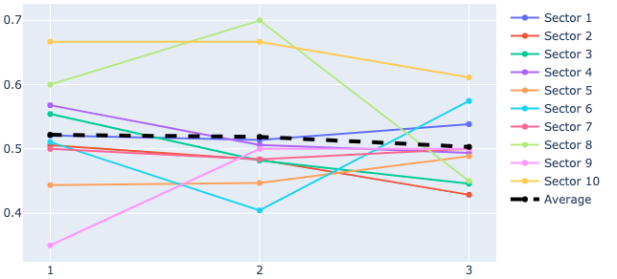
Appendix
Sector Default Rate Average

Slide 29
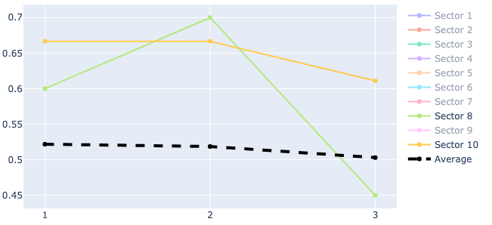
Appendix
Sector Default Rate Average (cont.)
Above average rates of default: Sectors 8 and 10

Slide 30
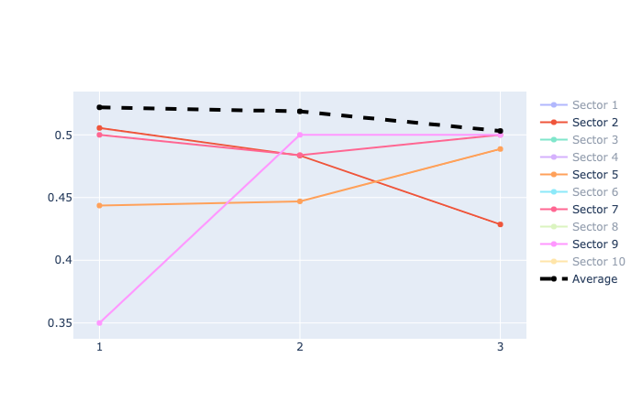
Appendix
Sector Default Rate Average (cont.)
Below average rates of default: Sectors 2, 5, 7, and 9

